Slide 1


Unleashing the Power of
Gemini Multimodal
Aman Kumar
Google Cloud Platform Corporate Trainer

Slide 2

Introduction to Multimodal AI
Core Capabilities of Google’s Multimodal AI-Gemini
Prompt Engineering Basics
How to access these Models
Agenda

Slide 3
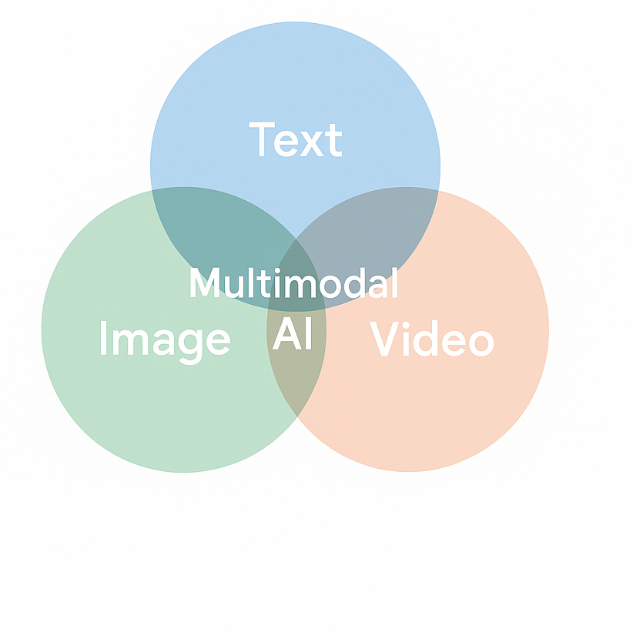
What are Multimodal AIs?
What is Multimodal AI? Ability to process and understand multiple data types—text, images, and video in a unified model.
Why It Matters? Just as humans combine sight, sound, and language to perceive the world, multimodal AI brings richer context and deeper insights.
Everyday Examples:
Describing the contents of an image in sentence
Generating video caption
Summarizing a multimedia presentation
Credits - https://www.cloudskillsboost.google/
Notes:
What is Multimodal AI?
Multimodal AI is a type of artificial intelligence that can understand and work with different types of data—like text, images, and video—all at once.
Instead of using one model for text and another for images, multimodal AI brings everything together into one smart system. So, it can look at a picture and read a question about it and answer in a clear sentence.”
💡
Why It Matters
“This is important because it’s how we humans work too. We don’t just use our eyes or ears alone—we use all our senses together to understand things better.
Multimodal AI tries to do the same. By combining different types of input, it gives more accurate answers and can understand complex situations.”
📱
Everyday Examples
“Let’s look at some simple examples where we use multimodal AI:
Describing an image in words – For example, saying ‘A dog is running on the beach’ after looking at a photo.
Adding captions to a video – It can explain what’s happening in a video, not just the spoken words.
Summarizing a presentation – It can look at slides, listen to the speaker, and give a short summary.”

Slide 4
Core Capabilities of Gemini
Natively Multimodal Processes and understands diverse data types—text, images, video, and audio—in a unified model.
Advanced Reasoning & Contextual Understanding Excels at tasks requiring logic, contextual knowledge, and multi-step reasoning.
Seamless Modality Transitions Interprets prompts that span formats—such as generating text descriptions from videos or answering questions about images.
Integration with Latest Generative Models Leverages cutting-edge models like Veo 3 and Imagen 4 for enhanced media generation capabilities.
Credits - https://www.cloudskillsboost.google/
Notes:
“Now that we know what multimodal AI is, let’s explore how Gemini, Google’s latest model, Gemini is built to understand and work with many types of information at the same time. It is Natively Multimodal:
🔹
Natively Multimodal
That means it can take in different types of data—like text, images, videos, and even audio—and process all of them in one model.
So whether you give it a photo with a question, a video with no words, or a paragraph of text, it understands all of it together—not separately.”
🔹
Advanced Reasoning & Contextual Understanding
“Second, Gemini is very good at solving problems that need logic and step-by-step thinking.
It doesn’t just give quick answers—it looks at the bigger picture. For example, it can answer a question by connecting facts from different parts of a long article or a video.”
🔹
Seamless Modality Transitions
“Third, it can move smoothly between different types of data. This means it can take a video and explain it in text. Or it can look at an image and answer questions about it.
You don’t have to tell it how to switch—it just knows. That’s what makes it feel natural to use.”
🔹
Integration with Latest Generative Models
“And finally, Gemini incorporates some of the most powerful models—like Veo 3 for video and Imagen 4 for images. These help it generate high-quality media content. For example, you can ask Gemini to create a realistic image or describe a video scene in rich detail.”

Slide 5
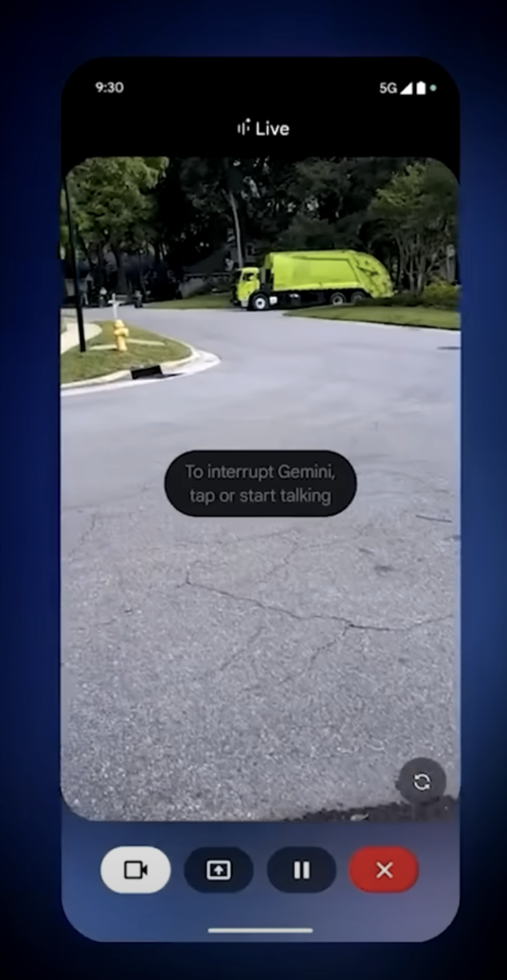
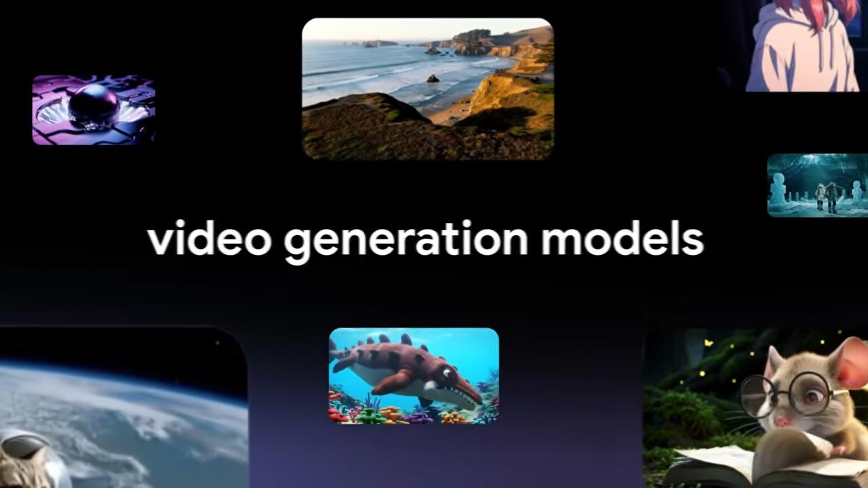
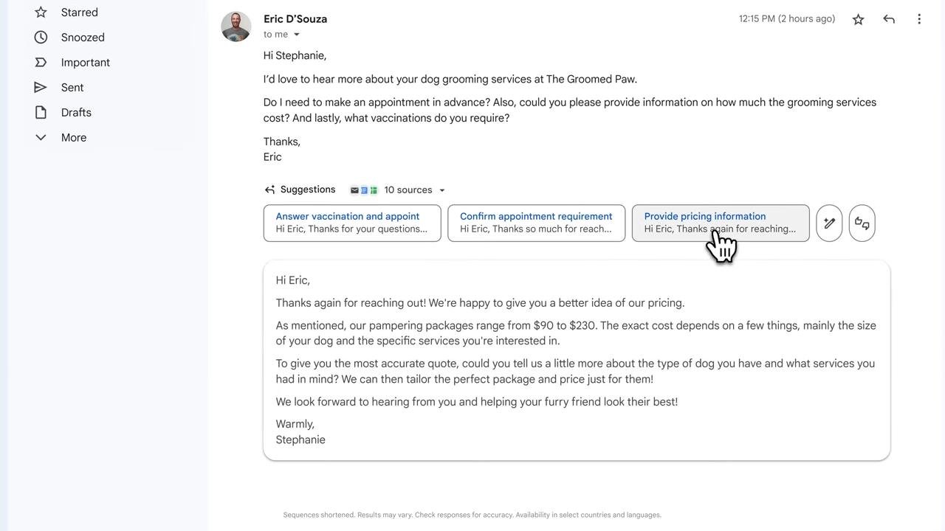
Advanced Capabilities of Gemini
Credits - https://www.cloudskillsboost.google/
Notes:
“Now let’s look at some of the latest and most exciting features Gemini has recently introduced.”
🖥️
1. Screen Sharing with AI Help
“Gemini can now work alongside you while you share your screen. Imagine you’re giving a presentation or working on a document—and Gemini can help you right there.
You can ask questions about what’s on your screen, and Gemini will understand the context and give helpful responses on the spot.”
🎬
2. Generating Videos with Native Audio
“Next, Gemini can now generate videos—not just visuals, but also the audio that goes with them.
So if you ask it to create a video about space exploration, it can generate the visuals and speak the narration in a natural voice. This makes it great for storytelling, marketing, and education.”
🎯
3. More Personalized Results
“Gemini is also getting better at personalization. It can remember your preferences during a session and tailor its answers to your style or needs.
For example, if you like short bullet-point summaries or visual guides, it adjusts automatically. This makes the experience smoother and more useful.”
To learn more about advancements in Gemini, you can refer to the website from Google’s I/O conference page, which is basically an annual Conference in which google showcases its most recent technological updates.

Slide 6
Prompt Engineering
The art of crafting effective instructions that guide the AI to generate accurate, useful, or creative responses.
Credits - https://www.cloudskillsboost.google/
Notes:
“Now that you’ve seen what Gemini can do, you might be wondering:
‘How do I get the best results out of it?’
This is where Prompt Engineering comes in.”
🔍
What Is Prompt Engineering?
“Prompt engineering is simply the art of giving better instructions to an AI—so it understands exactly what you want.
The way you ask a question or describe a task can really change the result. A well-written prompt can help Gemini give you smarter, more accurate, and more creative responses.”
📘
Google’s Official Guide
“To help you get started, Google has created a simple, hands-on guide for prompt engineering—specifically designed for Gemini.
It includes tips, examples, and even prompt templates for different tasks like summarizing, brainstorming, coding, or analyzing images.”

Slide 7
How to Access Gemini-MultiModal?
Gemini AI Website and Application
Google AI Studio
Vertex AI Studio for developers
Credits - https://www.cloudskillsboost.google/

Slide 8
Difference between Google AI Studio and Vertex AI Studio
Choose Google Al Studio If:
You are in the initial stages of testing different AI models, features and techniques.
You are exploring consumer or hobbyist use-cases that don't require enterprise data protections.
You seek a free and user-friendly platform for experimentation.
You are rapidly prototyping and testing prompts.
Choose Vertex Al Studio If:
You are looking to deploy and scale AI solutions to multiple users.
Enterprise-grade security and compliance are essential for your use-case.
Customization and fine-tuning of AI models using a variety of techniques is crucial for your project.
You're looking to use speech-to-text, text-to-speech, and text-to-image models.
Credits - https://www.cloudskillsboost.google/

Slide 9

Feel free to send in any questions
to info@koenig-solutions.com.

